Slide 1




COURNOT OLIGOPOLY
Incentive (%)
Tax ( €/Mwh)
Tr. B. (€)
G. B. (€)
2
S. | VRES gen. | % | Conv. gen. | Consum.
1 | 13477.1 | 24 | 43113.5 | 56590.6
2 | 11263.8 | 21 | 43113.5 | 54377.3
1
2
3
1M
1M
1
2
3
50
50
50
0
0
0
Line 1: 1 MW
Line 2: 1 MW
+ 4.334 MW
5 MW
8 MW
1
3
+ 9.936 MW
15 MW
+ 0.825 MW
8 MW
Line 3: 1 MW
5 MW
5 MW
+ 32.593 MW
+ 7.739 MW
Notes:
5

Slide 2
COURNOT OLIGOPOLY
Incentive (%)
Tax ( €/Mwh)
Tr. B. (€)
G. B. (€)
2
S. | VRES gen. | % | Conv. gen. | Consum.
1 | 17710.8 | 32 | 37348.4 | 55059.2
2 | 14892.7 | 29 | 37348.4 | 52241.1
1
2
3
1M
1M
1
2
3
50
50
50
30
30
30
Line 1: 1 MW
Line 2: 1 MW
+ 10.131 MW
+ 0.465 MW
5 MW
8 MW
1
3
18.472 MW
15 MW
+ 0.358 MW
8 MW
Line 3: 1 MW
5 MW
5 MW
+ 32.22 MW
Notes:
5

Slide 3
COURNOT OLIGOPOLY
COURNOT OLIGOPOLY
Tax ( €/Mwh)
Tr. B. (€)
G. B. (€)
Incentive (%)
Tax ( €/Mwh)
Tr. B. (€)
G. B. (€)
Incentive (%)
1
2
3
1M
1M
1
2
3
1
2
3
1M
1M
1
2
3
50
50
50
0
0
0
50
50
50
30
30
30
GENERATION
GENERATION
PRODUCER 1
PRODUCER 1
 | VRES | CONV
S1 | 0.0 | 3360.0
S2 | 0.0 | 3360.0
 | VRES | CONV
S1 | 218.50 | 3360.0
S2 | 187.29 | 3360.0
PRODUCER 2
PRODUCER 2
 | VRES | CONV
S1 | 8437.1 | 0.0
S2 | 7231.8 | 0.0
 | VRES | CONV
S1 | 12452.3 | 0.0
S2 | 10673.4 | 0.0
PRODUCER 1
PRODUCER 1
PRODUCER 1
PRODUCER 1
 | VRES | CONV
S1 | 5040.0 | 554.42
S2 | 4032.0 | 554.42
 | VRES | CONV
S1 | 0.0 | 25262.7
S2 | 0.0 | 25262.7
 | VRES | CONV
S1 | 5040.0 | 240.82
S2 | 4032.0 | 240.82
 | VRES | CONV
S1 | 0.0 | 25011.6
S2 | 0.0 | 25011.6
PRODUCER 2
PRODUCER 2
PRODUCER 2
PRODUCER 2
 | VRES | CONV
S1 | 0.0 | 5376.0
S2 | 0.0 | 5376.0
 | VRES | CONV
S1 | 0.0 | 8560.33
S2 | 0.0 | 8560.33
 | VRES | CONV
S1 | 0.0 | 5376.0
S2 | 0.0 | 5376.0
 | VRES | CONV
S1 | 0.0 | 3360.0
S2 | 0.0 | 3360.0

Slide 4
COURNOT OLIGOPOLY
COURNOT OLIGOPOLY
Tax ( €/Mwh)
Tr. B. (€)
G. B. (€)
Incentive (%)
Tax ( €/Mwh)
Tr. B. (€)
G. B. (€)
Incentive (%)
1
2
3
1M
1M
1
2
3
1
2
3
1M
1M
1
2
3
50
50
50
0
0
0
50
50
50
30
30
30
PRICE
PRICE
 | T1 | T2
S1 | 224.7 | 315.8
S2 | 292.6 | 297.3
 | T1 | T2
S1 | 228.4 | 318.0
S2 | 298.5 | 302.6
 | T1 | T2
S1 | 312.9 | 312.9
S2 | 291.9 | 297.3
 | T1 | T2
S1 | 302.9 | 302.9
S2 | 305.8 | 320.1
 | T1 | T2
S1 | 316.8 | 316.8
S2 | 295.8 | 302.6
 | T1 | T2
S1 | 306.6 | 306.6
S2 | 311.3 | 324.6

Slide 5
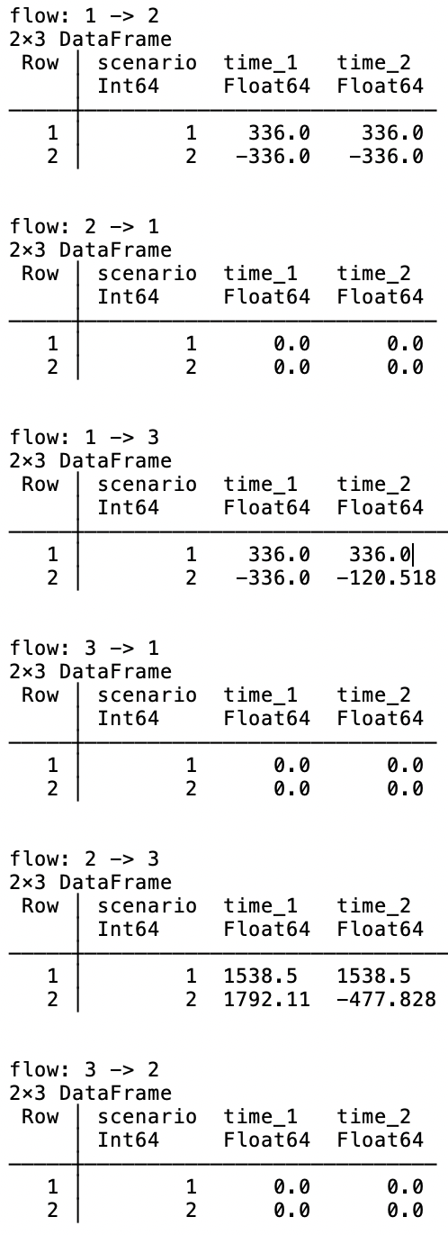
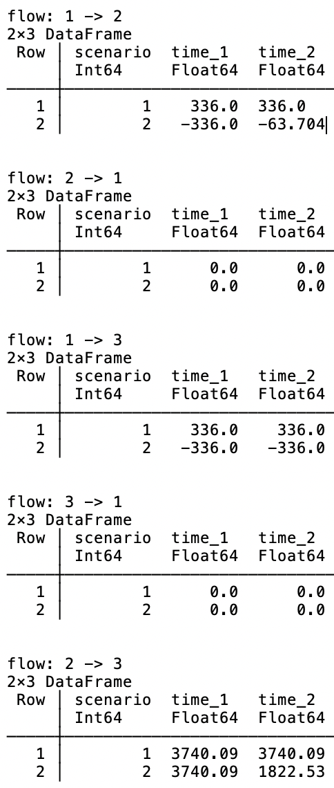
COURNOT OLIGOPOLY
COURNOT OLIGOPOLY
Tax ( €/Mwh)
Tr. B. (€)
G. B. (€)
Incentive (%)
Tax ( €/Mwh)
Tr. B. (€)
G. B. (€)
Incentive (%)
1
2
3
1M
1M
1
2
3
1
2
3
1M
1M
1
2
3
50
50
50
0
0
0
50
50
50
30
30
30
Energy flow
Energy flow

Slide 6
COURNOT OLIGOPOLY
COURNOT OLIGOPOLY
Tax ( €/Mwh)
Tr. B. (€)
G. B. (€)
Incentive (%)
Tax ( €/Mwh)
Tr. B. (€)
G. B. (€)
Incentive (%)
1
2
3
1M
1M
1
2
3
1
2
3
1M
1M
1
2
3
50
50
50
0
0
0
50
50
50
30
30
30
EXPENSES / PROFITS
EXPENSES / PROFITS
TSO
Inv. costs | -105468.44
Op. costs | -6333.37
TSO
Inv. costs | -246563.21
Op. costs | -9155.26
Producer 1
Inv. costs | -1.0e6
Other costs | -7.4817832e6
Producer 2
Inv. costs | -1.0e6
Other costs | -7.2136674e6
Producer 1
Inv. costs | -1.0e6
Other costs | -6.6645568e6
Producer 2
Inv. costs | -1.0e6
Other costs | -6.6020205e6
Total welfare: 6.218270549147273e6
Total welfare: 6.33495498079357e6
REVENUE
Node 1 | 3.2028777e6
Node 2 | 2.6389637e6
Node 3 | 1.10400107e7
REVENUE
Node 1 | 3.1377433e6
Node 2 | 2.5953181e6
Node 3 | 1.08020388e7

Slide 7
COURNOT OLIGOPOLY
Incentive (%)
Tax ( €/Mwh)
Tr. B. (€)
G. B. (€)
2
S. | VRES gen. | % | Conv. gen. | Consum.
1 | 25688.5 | 47 | 29198.7 | 54887.1
2 | 21730.7 | 43 | 29198.7 | 50929.4
1
2
3
1M
1M
1
2
3
50
50
50
50
50
50
Line 1: 1 MW
Line 2: 1 MW
+ 20.545 MW
+ 10.035 MW
5 MW
8 MW
1
+ 25.86 MW
3
15 MW
8 MW
Line 3: 1 MW
5 MW
5 MW
+ 20.45 MW
Notes:
5

Slide 8
COURNOT OLIGOPOLY
Incentive (%)
Tax ( €/Mwh)
Tr. B. (€)
G. B. (€)
2
S. | VRES gen. | % | Conv. gen. | Consum.
1 | 30642.2 | 47 | 34758.2 | 65400.5
2 | 25793.4 | 43 | 34758.2 | 60551.6
1
2
3
1M
1M
1
2
3
50
50
50
70
70
70
Line 1: 1 MW
Line 2: 1 MW
+ 20.545 MW
+ 6.055 MW
5 MW
8 MW
1
3
+ 33.548 MW
15 MW
+ 9.552 MW
8 MW
Line 3: 1 MW
5 MW
5 MW
+ 28.724 MW
Notes:
5

Slide 9
COURNOT OLIGOPOLY
COURNOT OLIGOPOLY
Tax ( €/Mwh)
Tr. B. (€)
G. B. (€)
Incentive (%)
Tax ( €/Mwh)
Tr. B. (€)
G. B. (€)
Incentive (%)
1
2
3
1M
1M
1
2
3
1
2
3
1M
1M
1
2
3
50
50
50
50
50
50
50
50
50
70
70
70
GENERATION
GENERATION
PRODUCER 1
PRODUCER 1
 | VRES | CONV
S1 | 4720.5 | 3360.0
S2 | 4046.2 | 3360.0
 | VRES | CONV
S1 | 2848.3 | 3360.0
S2 | 2441.4 | 3360.0
PRODUCER 2
PRODUCER 2
 | VRES | CONV
S1 | 15928.0 | 0.0
S2 | 13652.5 | 0.0
 | VRES | CONV
S1 | 19544.3 | 0.0
S2 | 16752.3 | 0.0
PRODUCER 1
PRODUCER 1
PRODUCER 1
PRODUCER 1
 | VRES | CONV
S1 | 5040.0 | 0.0
S2 | 4032.0 | 0.0
 | VRES | CONV
S1 | 0.0 | 17102.7
S2 | 0.0 | 17102.7
 | VRES | CONV
S1 | 5040.0 | 0.0
S2 | 4032.0 | 0.0
 | VRES | CONV
S1 | 0.0 | 22662.2
S2 | 0.0 | 22662.2
PRODUCER 2
PRODUCER 2
PRODUCER 2
PRODUCER 2
 | VRES | CONV
S1 | 0.0 | 5376.0
S2 | 0.0 | 5376.0
 | VRES | CONV
S1 | 0.0 | 3360.0
S2 | 0.0 | 3360.0
 | VRES | CONV
S1 | 3209.6 | 5376.0
S2 | 2567.7 | 5376.0
 | VRES | CONV
S1 | 0.0 | 3360.0
S2 | 0.0 | 3360.0

Slide 10
COURNOT OLIGOPOLY
COURNOT OLIGOPOLY
Tax ( €/Mwh)
Tr. B. (€)
G. B. (€)
Incentive (%)
Tax ( €/Mwh)
Tr. B. (€)
G. B. (€)
Incentive (%)
1
2
3
1M
1M
1
2
3
1
2
3
1M
1M
1
2
3
50
50
50
50
50
50
50
50
50
70
70
70
PRICE
PRICE
 | T1 | T2
S1 | 219.2 | 312.8
S2 | 302.1 | 305.9
 | T1 | T2
S1 | 167.9 | 284.0
S2 | 268.8 | 281.9
 | T1 | T2
S1 | 312.8 | 312.8
S2 | 298.8 | 305.9
 | T1 | T2
S1 | 309.7 | 309.7
S2 | 314.4 | 327.3
 | T1 | T2
S1 | 279.7 | 279.7
S2 | 267.2 | 281.9
 | T1 | T2
S1 | 290.4 | 290.4
S2 | 295.0 | 307.2

Slide 11
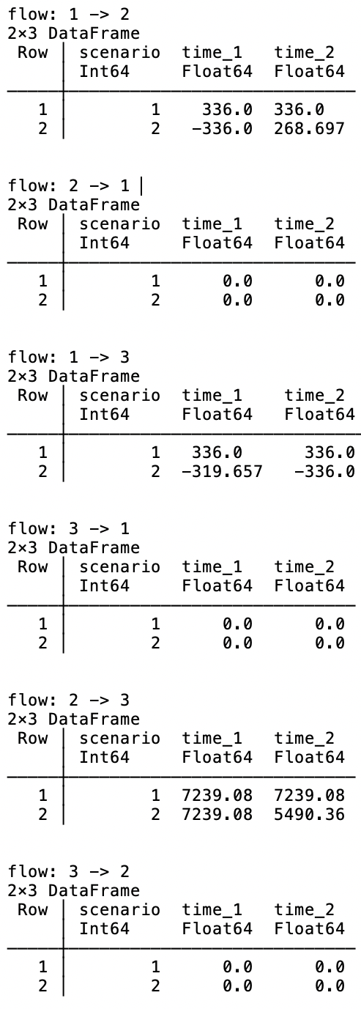
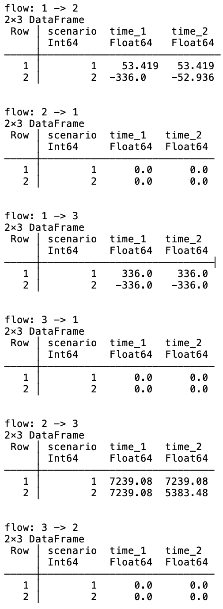
COURNOT OLIGOPOLY
COURNOT OLIGOPOLY
Tax ( €/Mwh)
Tr. B. (€)
G. B. (€)
Incentive (%)
Tax ( €/Mwh)
Tr. B. (€)
G. B. (€)
Incentive (%)
1
2
3
1M
1M
1
2
3
1
2
3
1M
1M
1
2
3
50
50
50
50
50
50
50
50
50
70
70
70
Energy flow
Energy flow

Slide 12
COURNOT OLIGOPOLY
COURNOT OLIGOPOLY
Tax ( €/Mwh)
Tr. B. (€)
G. B. (€)
Incentive (%)
Tax ( €/Mwh)
Tr. B. (€)
G. B. (€)
Incentive (%)
1
2
3
1M
1M
1
2
3
1
2
3
1M
1M
1
2
3
50
50
50
50
50
50
50
50
50
70
70
70
EXPENSES / PROFITS
EXPENSES / PROFITS
TSO
Inv. costs | -500000.0
Op. costs | -14224.00
TSO
Inv. costs | -500000.0
Op. costs | -14224.00
Producer 1
Inv. costs | -1.0e6
Other costs | -5.6798703e6
Producer 2
Inv. costs | -1.0e6
Other costs | -5.7362261e6
Producer 1
Inv. costs | -1.0e6
Other costs | -6.4535508e6
Producer 2
Inv. costs | -1.0e6
Other costs | -7.2180783e6
Total welfare: 6.589227649666158e6
Total welfare: 6.700318525488517e6
REVENUE
Node 1 | 3.1244973e6
Node 2 | 2.5988277e6
Node 3 | 1.06354149e7
REVENUE
Node 1 | 3.4810204e6
Node 2 | 2.8265749e6
Node 3 | 1.16255279e7

